Slide 1
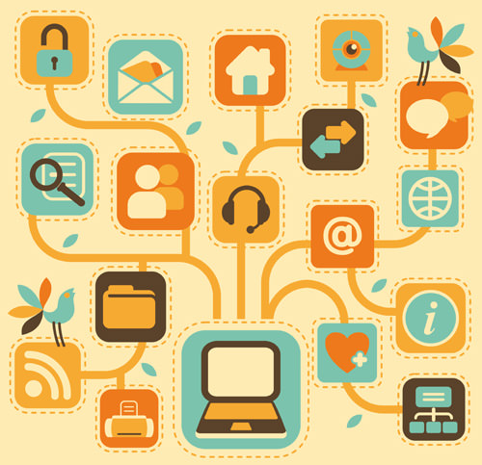
INFO 215: Week 4b
The Evolution of the Web

Slide 2
Web = platform
Web 1.0: Web pages
few (creators) > many (consumers)
little interaction
Web 2.0: Web apps
many (creators/consumers) > many (creators/consumers)
complex interactions
Web 3.0: Web devices
ubiquitous/embedded/Internet of Things (IoT)
personalization
semantic web
blockchain
???

Slide 3
Commercial Operations Differences between Web 1.0 and Web 2.0
Web 1.0
Corporations provided platforms and content to attract users.
Web 2.0
Corporations provide platforms to attract users.
Users provide content to attract users.

Slide 4
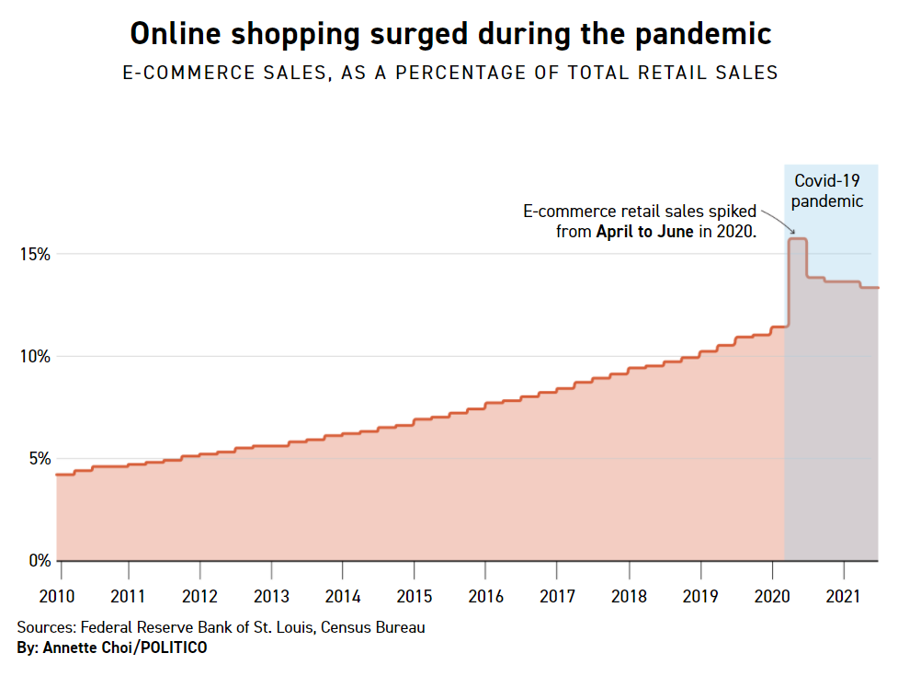
Web 2.0 = Money, Money, Money
From: Politico, 2021, https://www.politico.com/news/2021/11/18/covid-retail-e-commerce-environment-522786

Slide 5
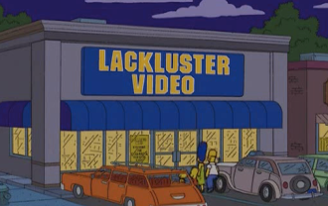
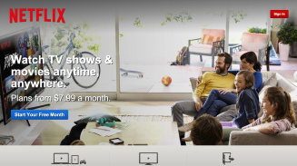
Long Tail Business Strategies
Exploit the long tail.
Bits are cheap.
Rarely-used items are cheap to store and they generate revenue.
Social networks can support customers to access content.

Slide 6
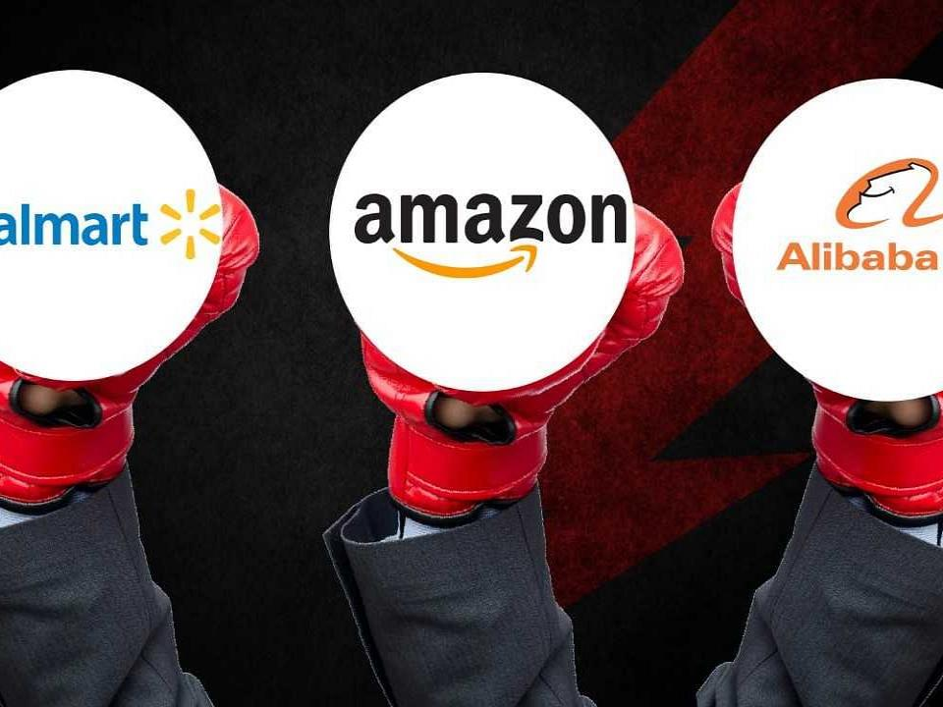
In August of 2021, the Wall Street Journal reported that Amazon had replaced Walmart as the largest retailer in the world outside of China.
Alibaba’s (China’s e-commerce giant) sales are about twice that of Amazon’s.
FISCAL YEAR 2021 SALES
Walmart | $566 billion
Amazon | $610 billion

Slide 7
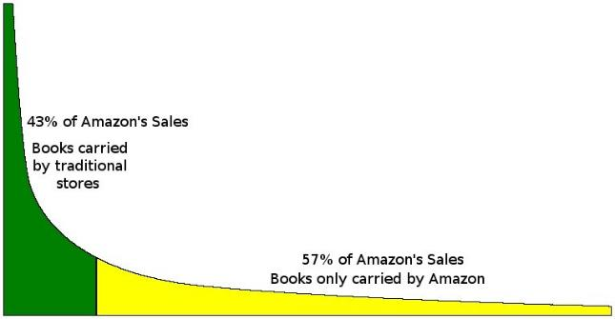
“The theory of ‘the long tail’ is that our culture and economy is increasingly shifting away from a focus on a relatively small number of ‘hits’ (mainstream products and markets) at the head of the demand curve and toward a huge number of niches in the tail.”
--Chris Anderson (http://www.longtail.com/about.html)
Amazon.com example. Other examples?

Slide 8
The Other Big Web 2.0 Innovation = Social Media
Characteristics
User profiles
Public or semi-public audiences
User-generated content -- participatory
Connections among users – dialogue vs. one-way information transmission
Hard to pinpoint exactly which social network site (SNS) was first. Classmates.com, 1995? Six Degrees, 1996? Both had profiles, friends lists, and school connections.
First widely popular SNS: friendster (2003-2013) – 115 million users in 2011

Slide 9
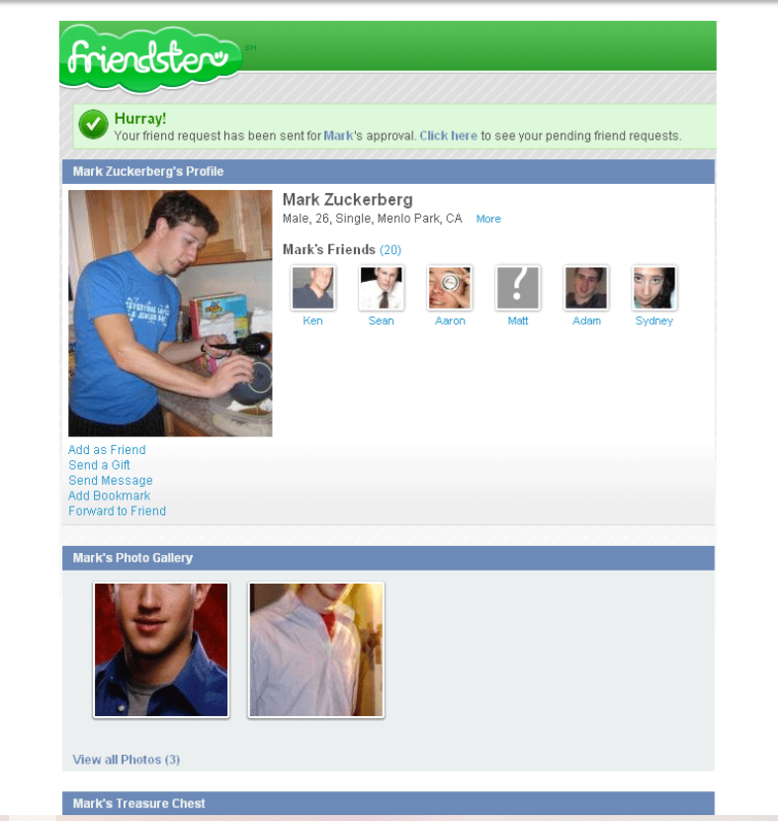
Friendster launched in 2003.
Facebook launched in 2004.
Source: Wired, https://www.wired.com/?p=33996 (photo circa 2004)

Slide 10
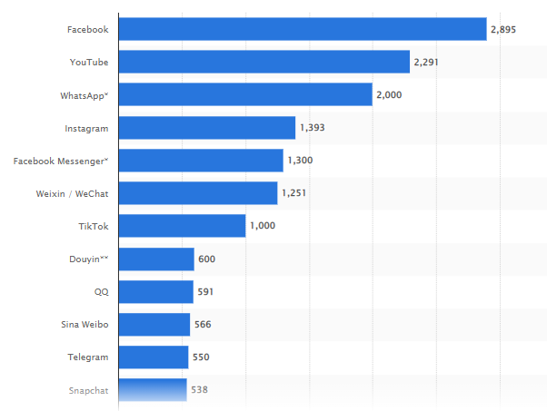
Most popular social networks worldwide as of October 2021, ranked by number of active users (in millions)
WeChat = Chinese super-app
Douyin = Chinese version of TikTok
QQ = Chinese instant messaging
Sina Weibo = Chinese, similar to Twitter
Telegram = UAE & UK-based instant messaging & video calling
https://www.statista.com/statistics/272014/global-social-networks-ranked-by-number-of-users/

Slide 11
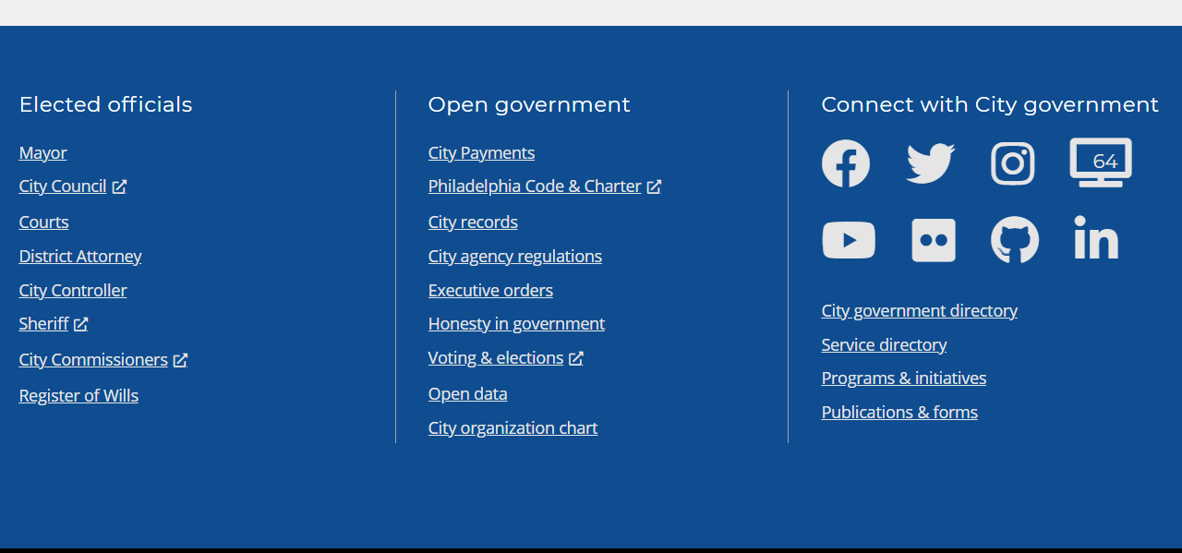
What can the evolution of social media teach us about the impact of technology on society?
The lines between other types of digital media and SNS have blurred – YouTube? New York Times? Minecraft? Zoom? City of Philadelphia website?
The bottom of this page: https://www.phila.gov/,
as of 01/04/22.

Slide 12
Most Popular Websites of 2021 (in our class)
Which five websites have you visited the most within the past week? Think for a minute, and then write them down.

Slide 13
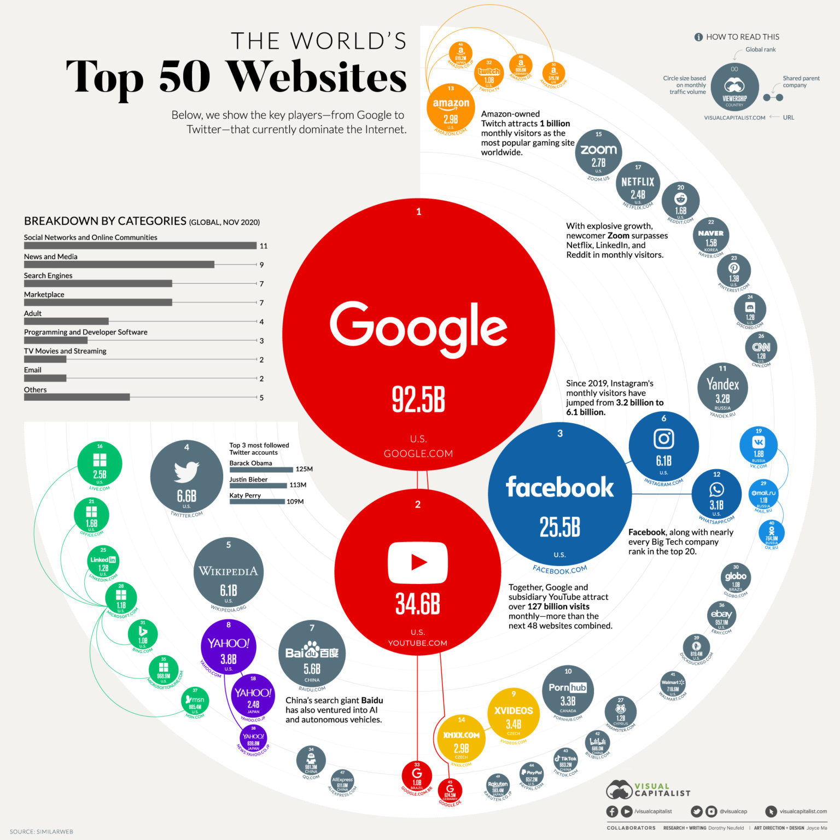
01/2021
https://www.visualcapitalist.com/the-50-most-visited-websites-in-the-world/

Slide 14
https://www.similarweb.com/top-websites/

Slide 15
Summary so far…
Web 1.0 was conceived as scientific network, but was adopted as a social tool. It was a static repository and a library of information.
Web 2.0 was conceived a business platform, but was adopted as a social tool, with emergent functionality. It emphasized interconnectivity and making connections between users, especially via social media platforms.

Slide 16
Web 1.0 versus Web 2.0
Broadcasting versus Sharing
Monologue versus Dialogue
Static versus Dynamic
Passive versus Active
Individual versus Community
Owner content versus User content
Owner categories versus User categories
Consumption versus Re-use
Silo versus Mashup
Hub and spoke versus Network

Slide 17
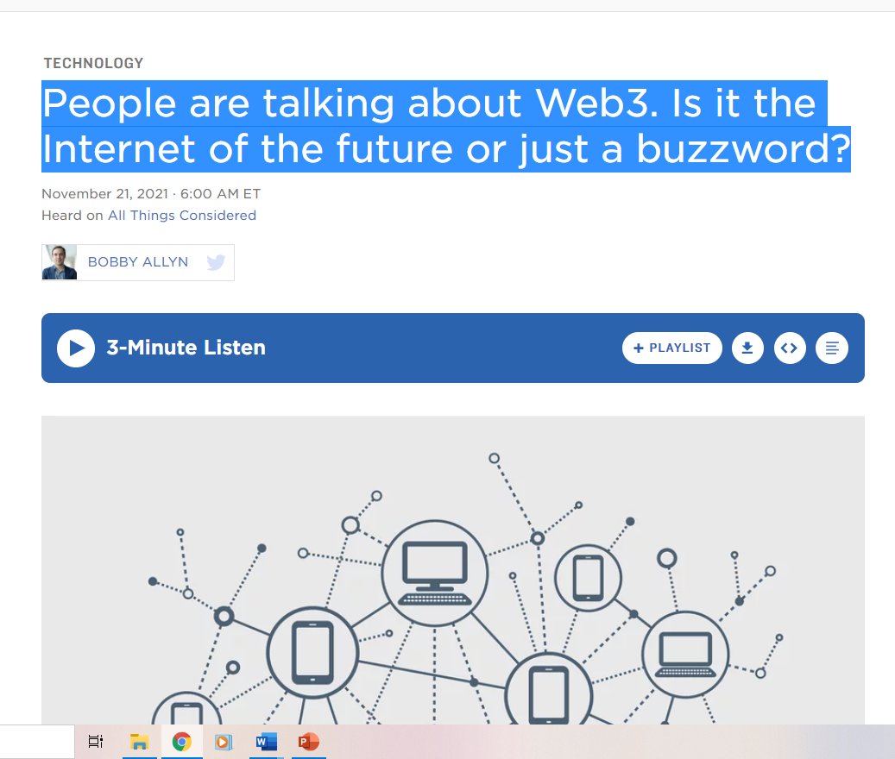
Now that we’re in Web 3.0, how is it playing out?

Slide 18
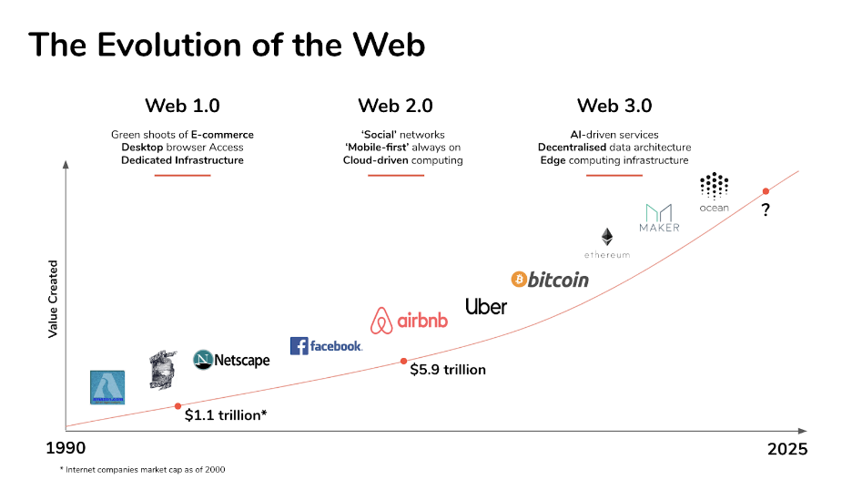
Web 1.0 and 2.0 and 3.0
Bitcoin trade began in 2009.
Source: https://medium.com/fabric-ventures/what-is-web-3-0-why-it-matters-934eb07f3d2b

Slide 19
Blockchain & Web 3.0
Gives users back control over their data.
One major trend is blockchain.
Began with bitcoin in 2008 – introduced the concepts of distributed ledgers and decentralization
As of yet, blockchain is not taking over centralized business structures. Why?

Slide 20
Blockchain & Web 3.0
Gives users back control over their data.
One major trend is blockchain.
Began with bitcoin in 2008 – introduced the concepts of distributed ledgers and decentralization
As yet, blockchain is not taking over centralized business structures. Why?
Loss of control of behalf of big corporate and government players – Why would Amazon want to lose control over purchase transactions?

Slide 21
Blockchain & Web 3.0
Gives users back control over their data.
One major trend is blockchain.
Began with bitcoin in 2008 – introduced the concepts of distributed ledgers and decentralization
As yet, blockchain is not taking over centralized business structures. Why?
Loss of control of behalf of big corporate and government players – Why would Amazon want to lose control over purchase transactions?
As of yet, negative stigma attached to the blockchain. People don’t trust it…yet. Bitcoin volatility, for example, has scared people away.

Slide 22
Web 3.0 means peer-to-peer networks (Mersch & Muirhead, 2019)
Web 3.0 is a leap forward to open, trustless, and permissionless networks.
Open = networks are built from open source software built by an open and accessible community of developers and executed in public view
Trustless = networks enable participants to interact publicly or privately without a trusted third party
Permissionless = anyone (users and suppliers) can participate without authorization from a governing body

